Slide 1
Weekly Report
Zheng Huiwen

Slide 2
Content
The basic neural network
The Input
The Structure
The Output
How to choose the hyperparameters in neural networks

Slide 3
The Input of a neural network
The best data classification is to divide the data set into three parts:
Training set : Training data to fit the model and use this part of the data to build the model. Determining the optimal weight.
Validation set : Optimize the hyperparameters of the model. Hyperparameters are learning rate, number of layers, number of neurons per layer, etc.
Test set : Evaluating the model and reflecting the generalization ability of the model

Slide 4
The MNIST Dataset
70,000 black and white handwritten digital picture: 55,000 training sets, 5,000 validation sets and 10,000 test sets.
Each image is 28 by 28 pixels in size and will be converted to a one-dimensional array of length 784(28*28) when used.
Pure black pixel is 1, pure white pixel is 0.
The label of the data set is one-dimensional data with a length of 10, indicating the probability of the number in the image.

Slide 5
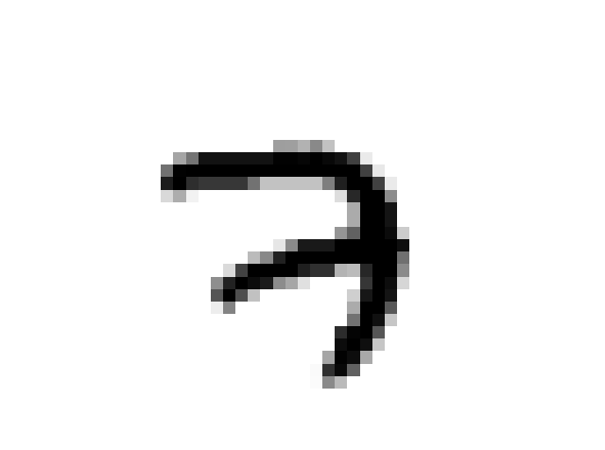
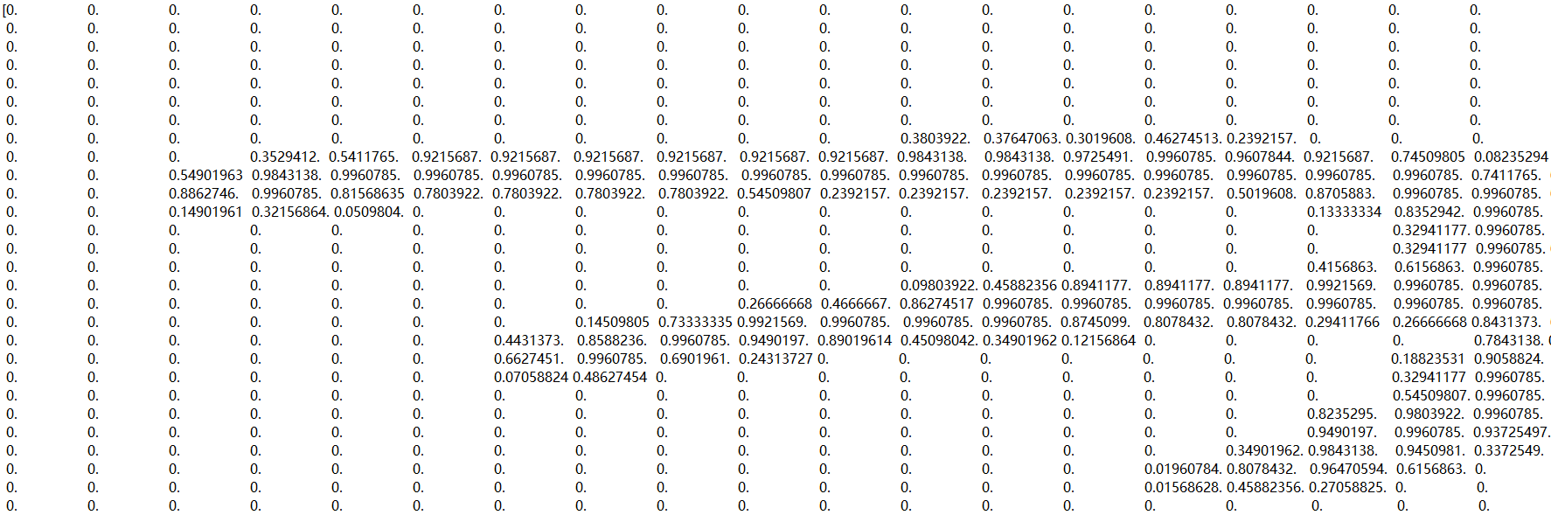
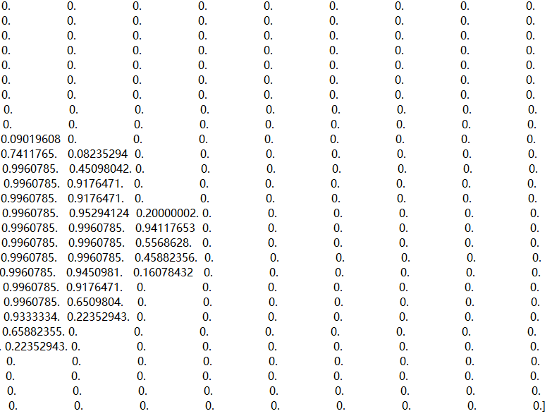
The MNIST Dataset
[0. 0. 0. 0. 0. 0. 0. 1. 0. 0.]

Slide 6
The Basic Structure of a neural network
Input Node
784
Hidden Node
(Variable)
Output Node
10

Slide 7


The Train Function
The Stochastic Gradient Descent Optimizer
Adjust model parameters along the direction of gradient descent to minimize the cost function.
Easy to settle into a local minimum.
The Momentum Optimizer
Accelerate convergence and reduce oscillations.
Miss the lowest point or oscillate near the lowest point.
The Adam Optimizer
An algorithm for first-order gradient-based optimization based on adaptive estimates of lower-order moments.

Slide 8

The Loss Function
Loss Function:
Used to estimate the degree of inconsistency between the predicted value of the model and the true value.
The output of the model
Softmax function
The probability distribution
Compared with the standard answer
The cross entropy
The loss function

Slide 9
The Output of the neural network
Training Method
 | SGD Optimizer | Momentum Optimizer | Adam Optimizer
100 | 95.14% | 97.78% | 97.77%
500 | 96.05% | 97.91% | 97.83%
1,000 | 96.43% | 97.94% | 97.92%
Hidden Layer

Slide 10
对于稀疏数据，尽量使用学习率可自适应的优化方法，不用手动调节，而且最好采用默认值
SGD通常训练时间更长，但是在好的初始化和学习率调度方案的情况下，结果更可靠
如果在意更快的收敛，并且需要训练较深较复杂的网络时，推荐使用学习率自适应的优化方法。

